Slide 1

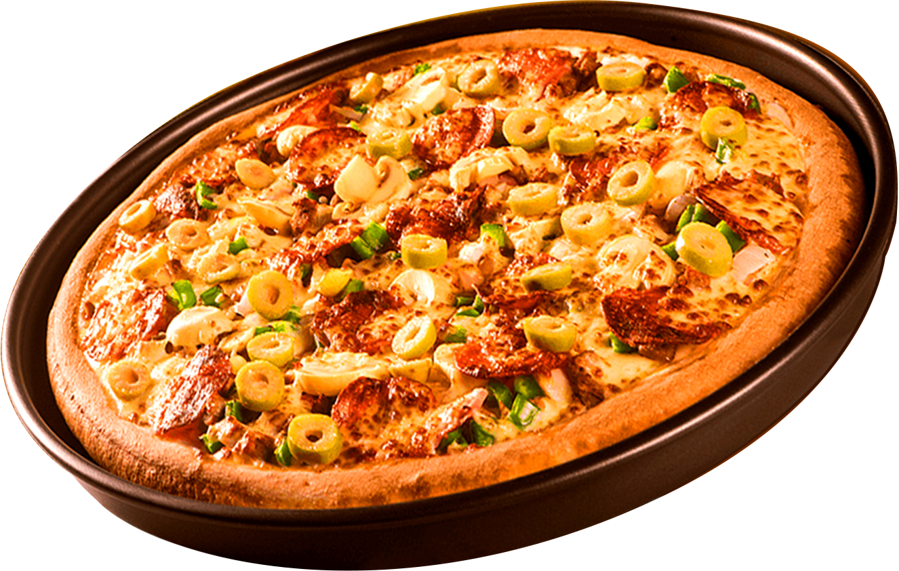

PIZZA SALES
ANALYSIS
A SQL PROJECT ON ANALYZING PIZZA SALES TRENDS
NEXT >

Slide 2

Hi everyone!
I have created a project using SQL to analyze sales data for a pizza company. Through a series of SQL queries, i have generated insights into sales trends and performance. This project is designed to showcase my SQL skills and my ability to turn data into actionable insights.
< BACK
NEXT >

Slide 3

Identify peak sales periods to optimize staffing and inventory.
Analyze sales fluctuations over time to identify patterns and trends.
Determine the most profitable pizza types and categories, based on revenue and order quantity.
Offer actionable recommendations to enhance sales and marketing strategies.
OBJECTIVE
< BACK

Slide 4

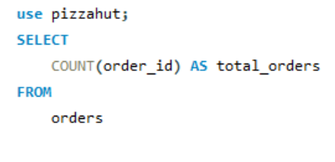
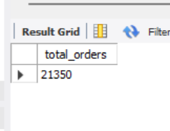
RETRIVE THE TOTAL NUMBER OF ORDER PLACED.
< BACK
NEXT >

Slide 5
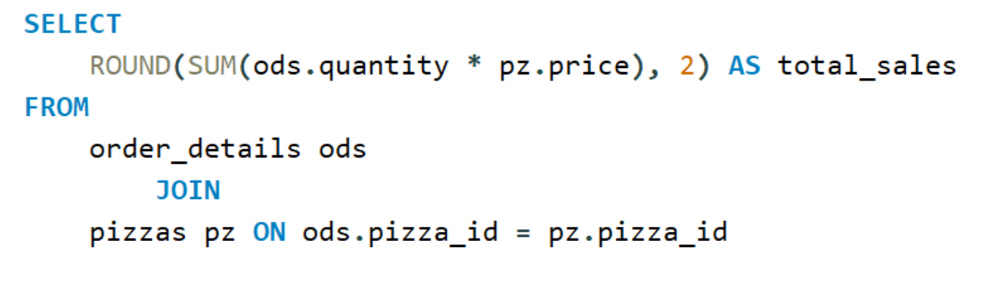
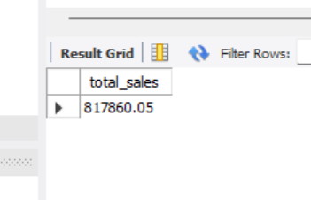
CALCULATE THE TOTAL REVENUE GENERATED FROM PIZZA SALES.
< BACK
NEXT >

Slide 6

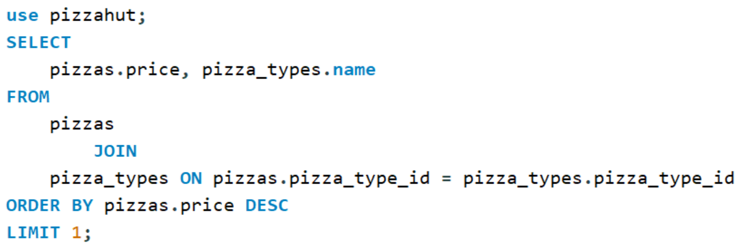
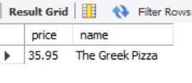
IDENTIFY THE HIGHEST-PRICE PIZZA.
< BACK
NEXT >

Slide 7

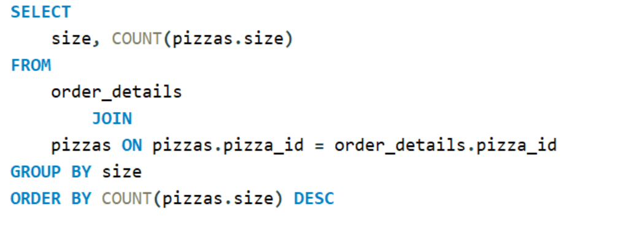
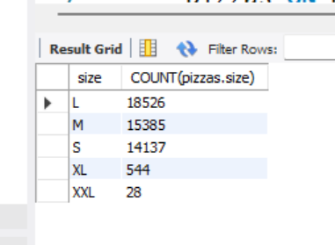
INDENTIFY THE MOST COMMON PIZZA SIZE ORDERED.
< BACK
NEXT >

Slide 8
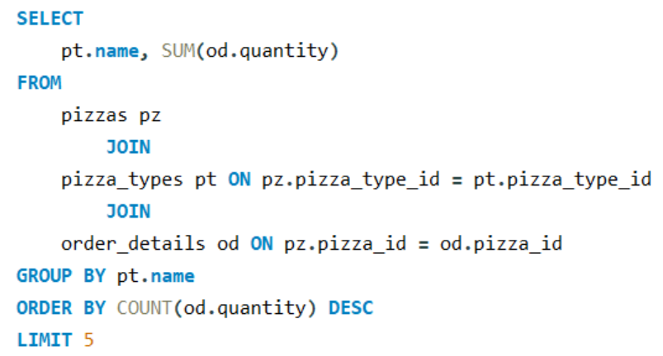

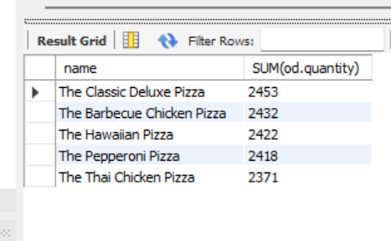
LIST THE TOP 5 MOST ORDERED PIZZA TYPES ALONG WITH THEIR QUANTITY
< BACK
NEXT >

Slide 9
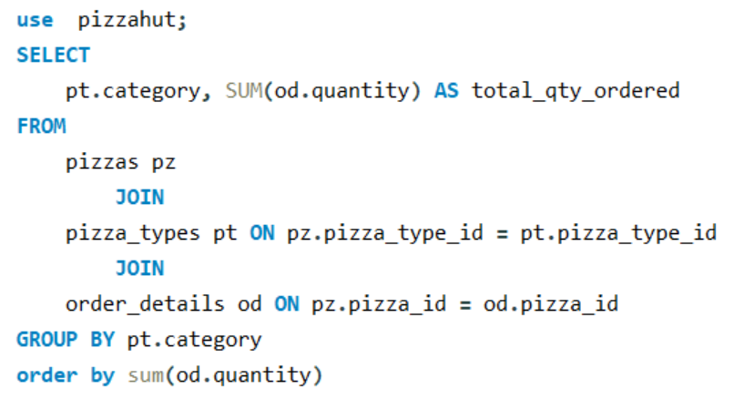
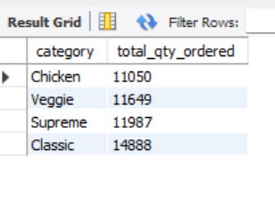
JOIN THE NECESSARY TABLES TO FIND THE TOTAL QUANTITY OF EACH PIZZA CATEGORY ORDERED
< BACK
NEXT >

Slide 10
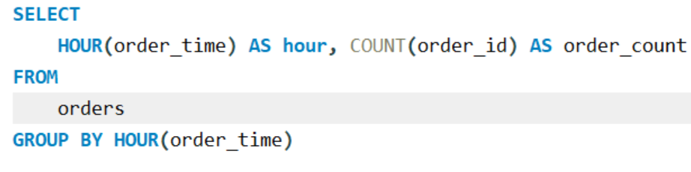
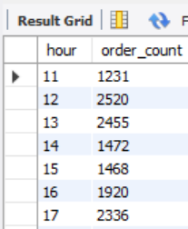

DETERMINE THE DISTRIBUTION OF ORDERS BY HOUR OF THE DAY
< BACK
NEXT >

Slide 11
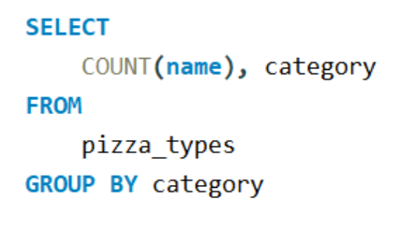
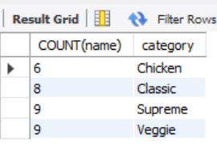
JOIN RELEVANT TABLES TO FIND THE CATEGORY WISE DISTRIBUTION OF PIZZAS.
< BACK
NEXT >

Slide 12
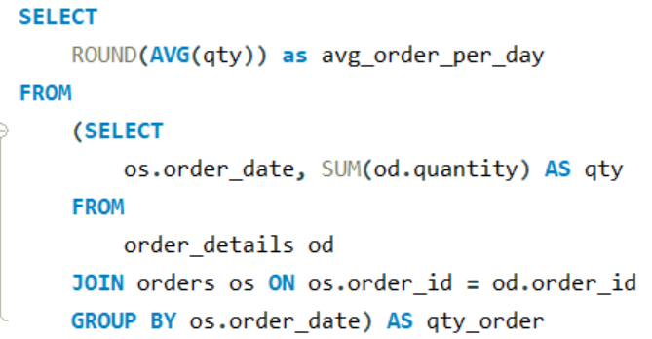
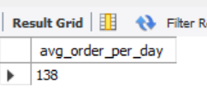
GROUP THE ORDERS BY DATE AND CALCULATE THE AVERAGE NUMBER OF PIZZAS ORDERED PER DAY.
< BACK
NEXT >

Slide 13

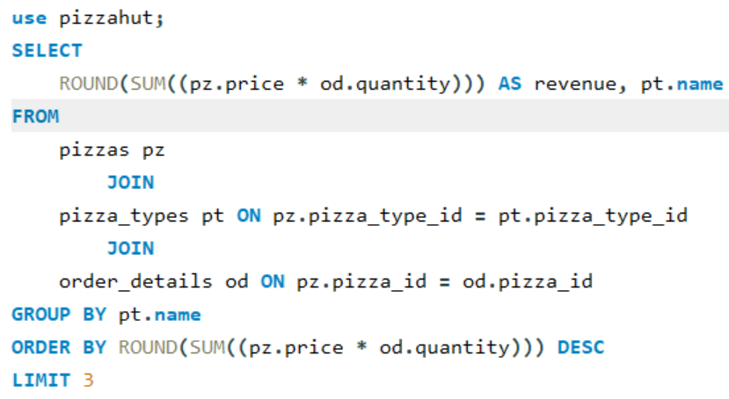
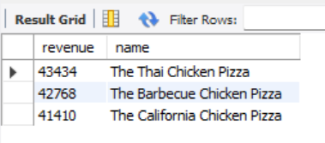
DETERMINE THE TOP 3 MOST ORDERED PIZZA TYPES BASED ON REVENUE
< BACK

Slide 14
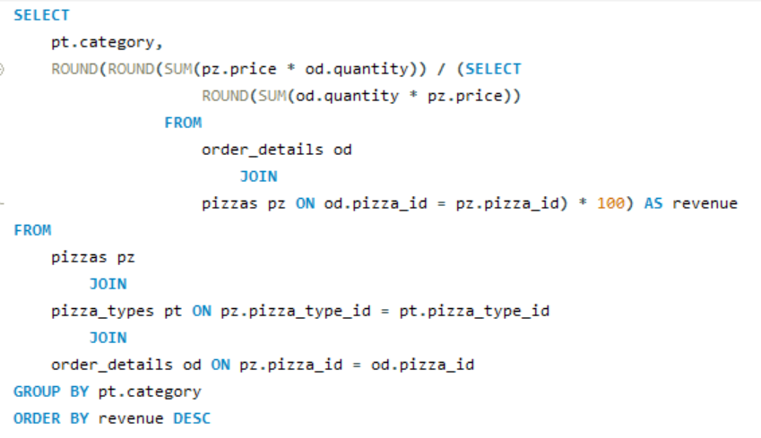
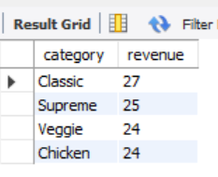
CALCULATE THE PERCENTAGE OF EACH PIZZA TYPE TO TOTAL REVENUE
< BACK
NEXT >

Slide 15
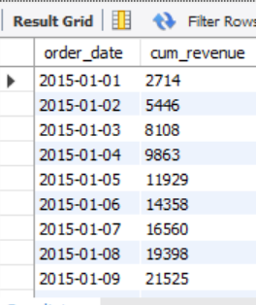
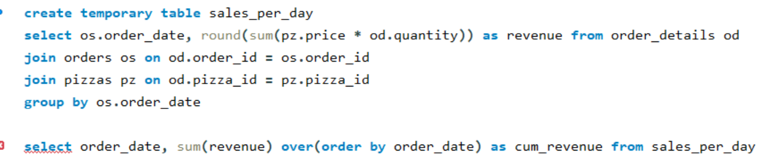
ANALYZE THE CUMULATIVE REVENUE GENERATED OVER TIME.
< BACK
NEXT >

Slide 16
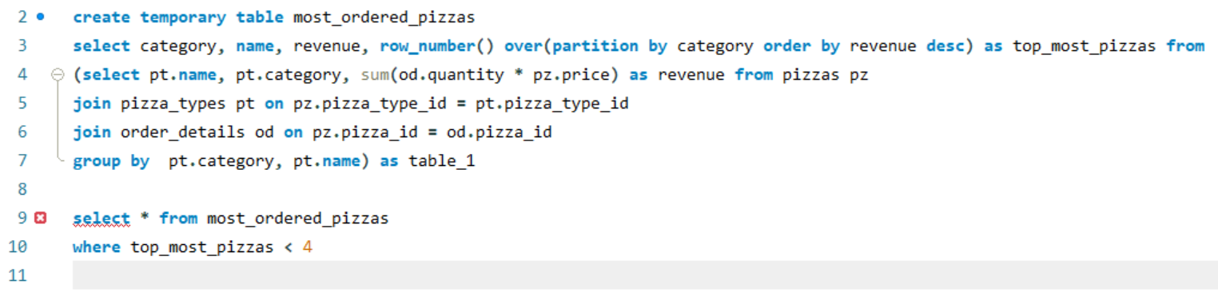
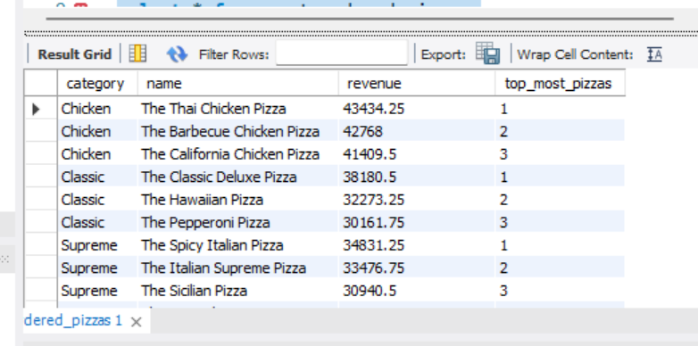
DETERMINE THE TOP 3 MOST ORDERED PIZZA TYPES BASED ON REVENUE FOR EACH PIZZA CATEGORY.
< BACK

Slide 17

Thank YOU!
SHUBKARAN.FZR@GMAIL.COM
< BACK

